Slide 1
Intro to Electrical Engineering
Day 3

Slide 2


Series circuit
The current flows the same, from one component to another.

Slide 3
Series circuit
The current flows the same, from one component to another.
When you plug in that second, third bulb, they will become equally dim. More resistance has been added to the circuit, which decreases the flow of current, as the battery has more work to do.

Slide 4
Series circuit
If a bulb is removed the circuit will be broken, and the electrons stop flowing.
The current flows the same, from one component to another.
When you plug in that second, third bulb, they will become equally dim. More resistance has been added to the circuit, which decreases the flow of current, as the battery has more work to do.

Slide 5
Series circuit
If a bulb is removed the circuit will be broken, and the electrons stop flowing.
The current flows the same, from one component to another.
When you plug in that second, third bulb, they will become equally dim. More resistance has been added to the circuit, which decreases the flow of current, as the battery has more work to do.

Slide 6
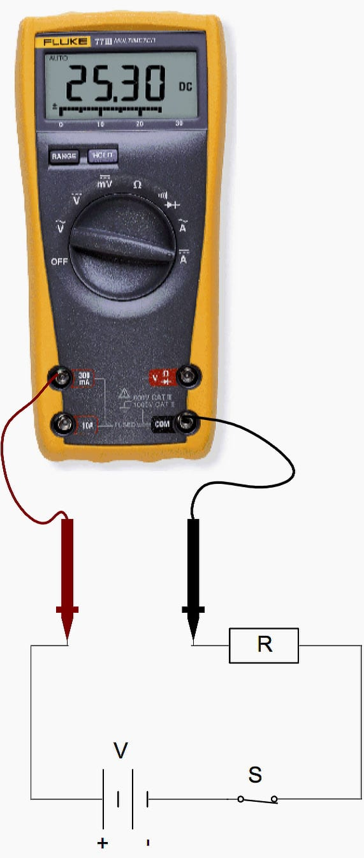
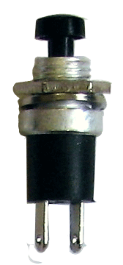
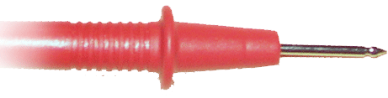
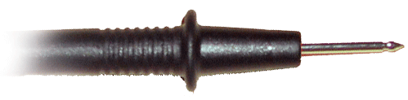

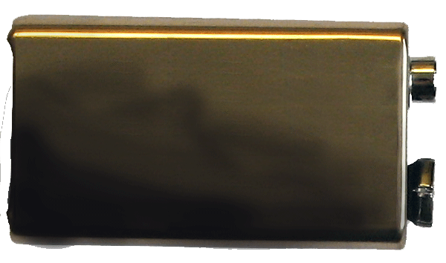

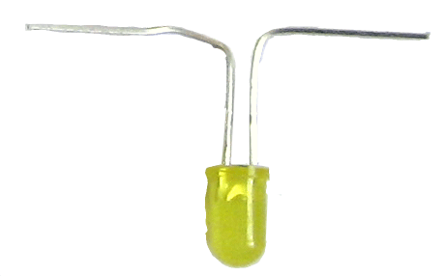
Measuring Current
Current is measured in series through a component
Switch
Battery
Resistor
Light

Slide 7
Parallel circuit
In a parallel circuit the bulbs will remain bright, but it will drain the battery power quicker.
Components connected in parallel are connected along multiple paths so that the current can split
up; the same voltage is applied to each component.
If a bulb is removed the electrons will continue to flow, as each bulb has its own circuit.

Slide 8
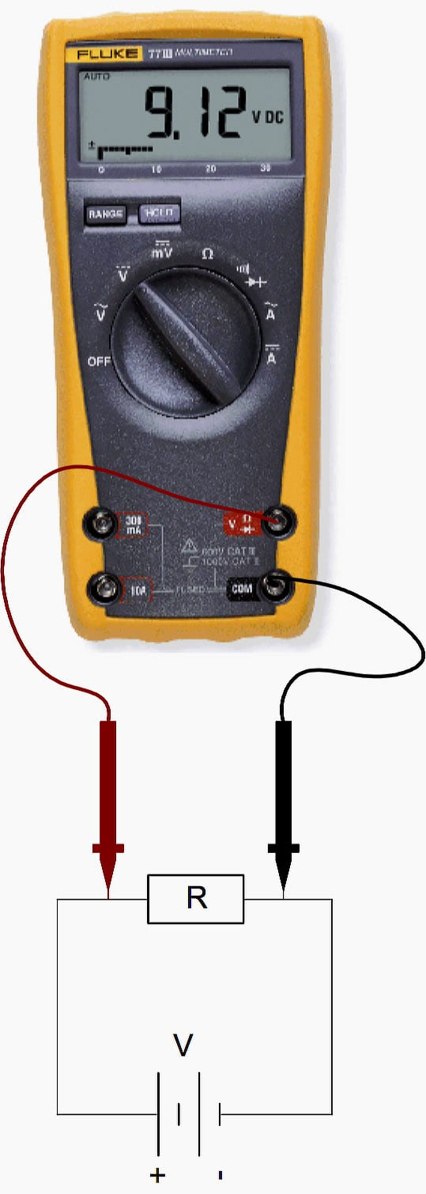

Measuring Voltage
Voltage is measured in parallel across a component
Switch
Battery
Resistor
Light

Slide 9
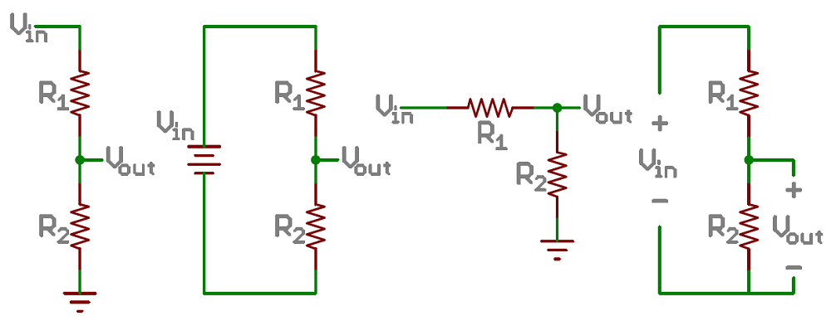
Voltage divider
One useful type of circuit is a voltage divider. It lets us decrease the voltage going to part of the circuit

Slide 10

Voltage divider
$$V_{out}=V_{in}\left[\frac{R_{2}}{R_{1}+R_{2}}\right]$$
One useful type of circuit is a voltage divider. It lets us decrease the voltage going to part of the circuit

Slide 11
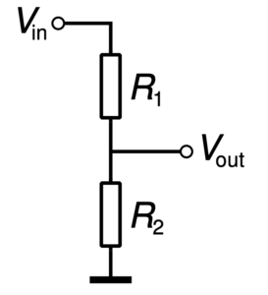
Voltage divider
$$V_{out}=V_{in}\left[\frac{R_{2}}{R_{1}+R_{2}}\right]$$
One useful type of circuit is a voltage divider. It lets us decrease the voltage going to part of the circuit
Example: Joaquin makes the following circuit. Calculate the voltage at the output
5v =
= 330Ω
= 1kΩ

Slide 12
Voltage divider
$$V_{out}=V_{in}\left[\frac{R_{2}}{R_{1}+R_{2}}\right]$$
One useful type of circuit is a voltage divider. It lets us decrease the voltage going to part of the circuit
Example: Build the circuit yourself and use your multimeter to calculate the voltage
5v =
= 330Ω
= 1kΩ

